Slide 1



Hybrid Energy Storage Based on Supercapacitors and Conventional Batteries System for
Nanosatellite Applications
5th SPACE PASSIVE COMPONENT DAYS - SPCD 2024
15-18 October 2024 | ESA/ESTEC
Noordwijk, The Netherlands
الجمهوريــة الجزائريــة الديمقراطية الشعبيــة
PEOPLE'S DEMOCRATIC REPUBLIC OF ALGERIA
الوكــــالة الفضـــائيــة الجزائريـــــة
Algerian Space Agency - ASAL
مركز تطوير الأقمار الصناعية
Satellites Development Center -CDS
AREZKI Faiza
Algerian Space Agency, Satellites Development Center

Slide 2
Outline
Introduction
Nanosatellite Energy Storage Systems
Supercapacitor: Modeling and Parameter Identification
Hybrid Energy Storage System
Conclusion

Slide 3
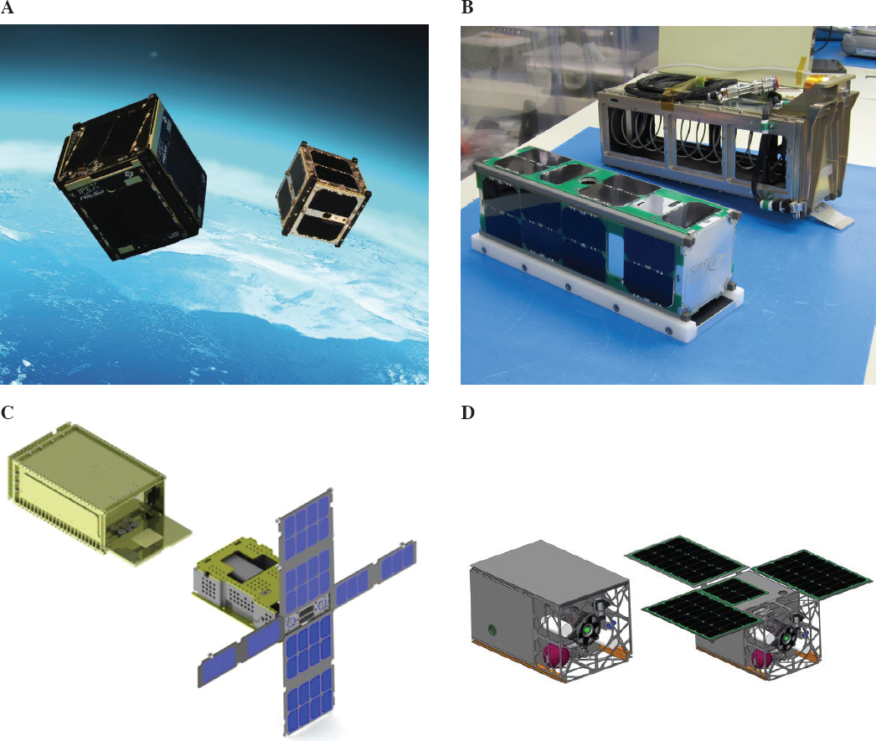
Introduction
Energy
Mass
Volume

Slide 4
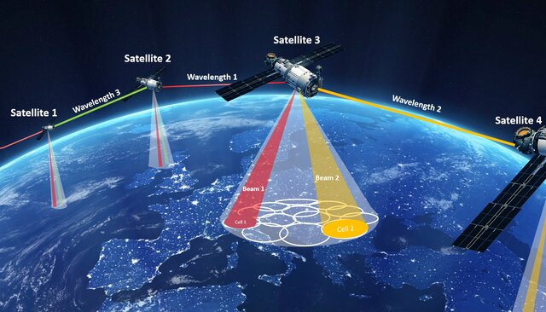
Introduction
[SHI Xia: Low-orbiting satellite network employs inter-satellite laser communication and optically controlled millimeter wave-phased array]

Slide 5
Introduction

Slide 6
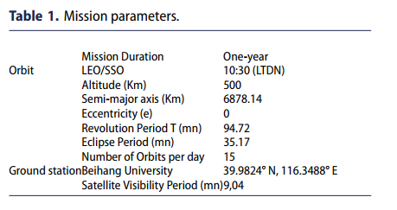
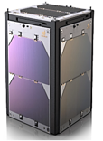
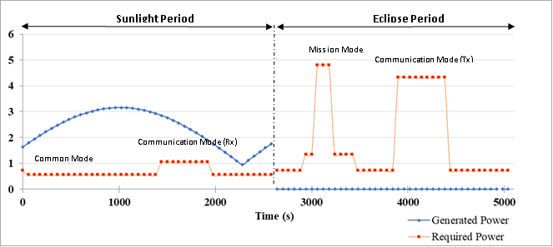
Nanosatellite Energy Storage Systems

Slide 7
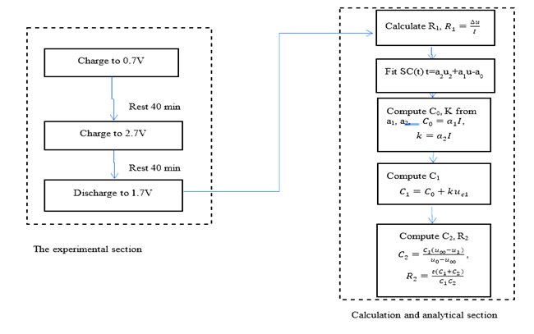
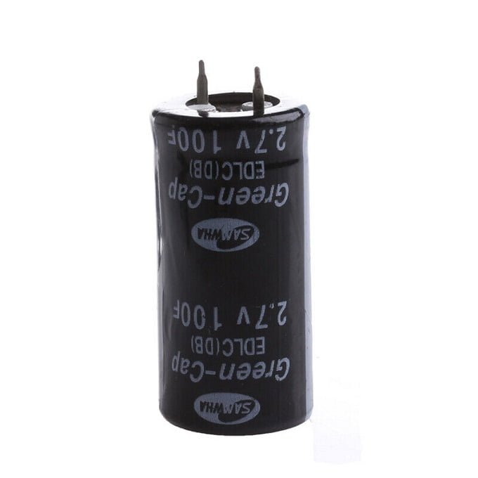
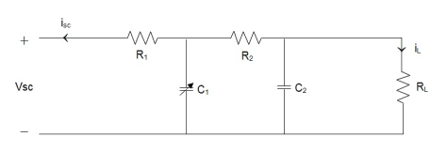
Supercapacitor: Modeling and Parameter Identification
Table2. Supercapacitor specifications.
Parameter: | Value | Unit
Rated Voltage | 2.7 | V
Rated Capacitance | 100 | F
AC Impedance (1khz) | 7 | mΩ
DC Resistance | 9 | mΩ
Maximum Peak Current (1s) | 71 | A
Leakage Current | 0.27 | mA
Max Continuous Current | 6.5 | A
The parameters values obtained are:
𝑡 = 4,0531𝑢2 + 39,5u - 0,357
𝑅1 = 0,01Ω
𝐶0 = 79𝐹
𝐶1 = 92,942𝐹
𝐶2 = 3,717𝐹
𝑅2 = 13,462Ω
Block diagram of procedure for parameters identification

Slide 8
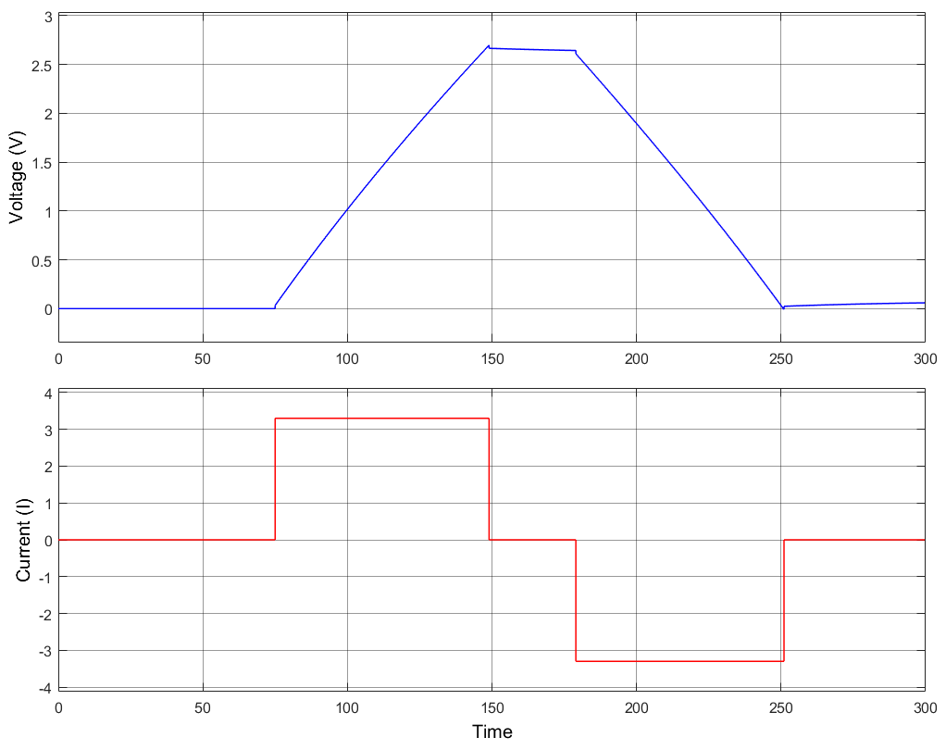
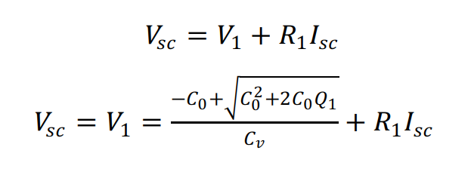
Supercapacitor: Modeling and Parameter Identification

Slide 9
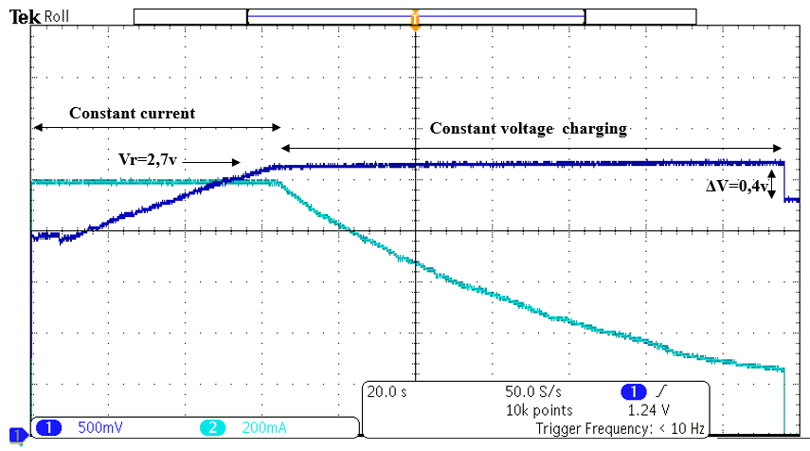
Supercapacitor charging profile

Slide 10
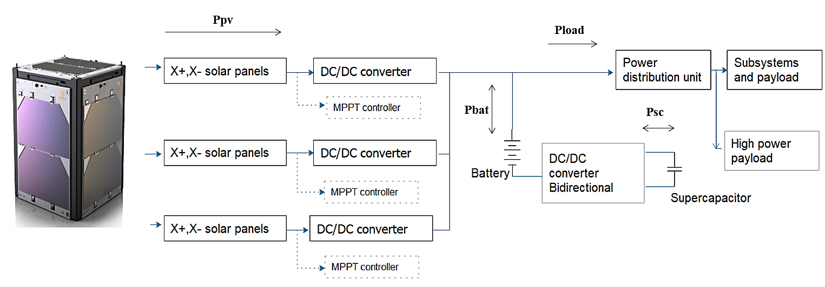
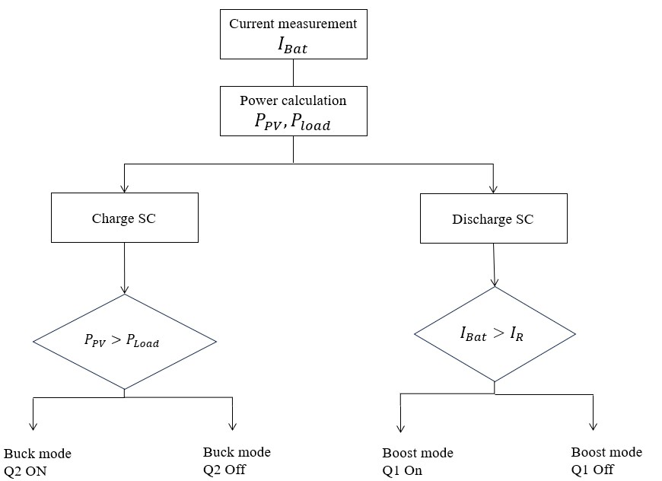
Hybrid Energy Storage System
Bloc diagram of the electrical power system
Flowchart of the operational modes of the power management

Slide 11
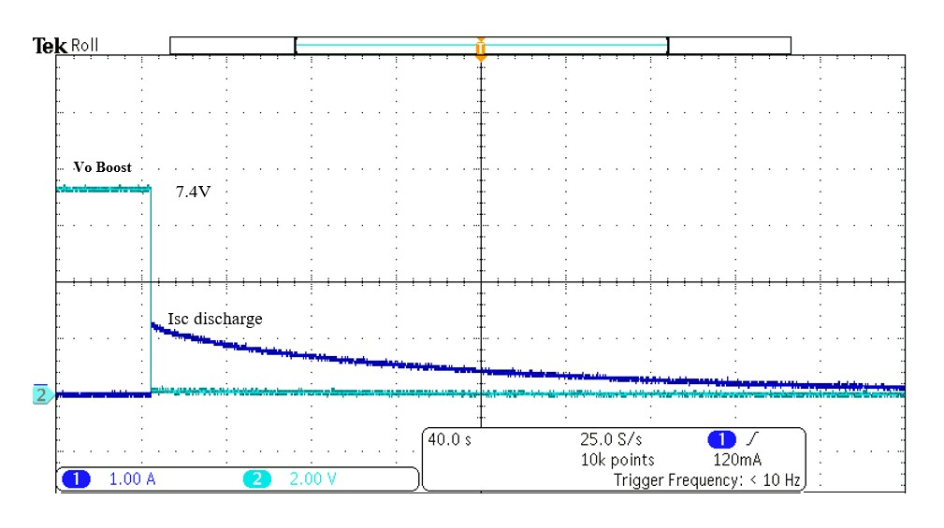
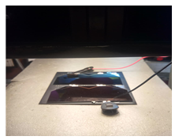
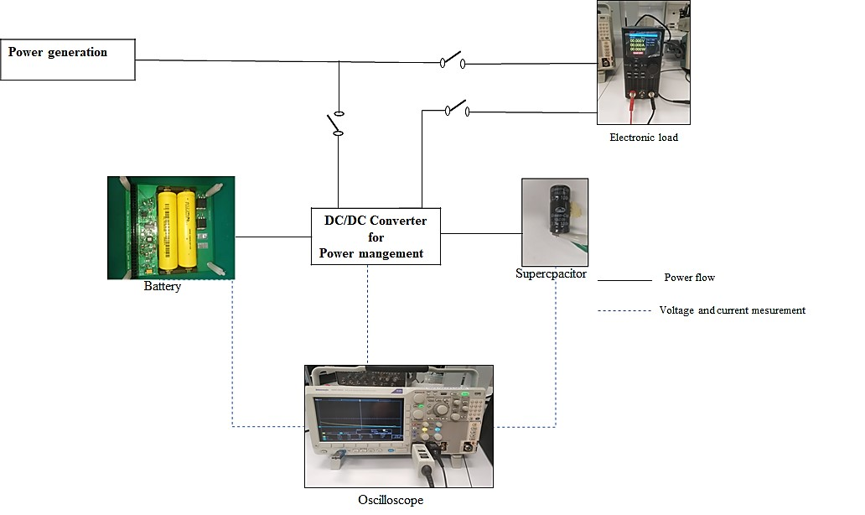
Hybrid Energy Storage System
Voltage and current across the converter

Slide 12
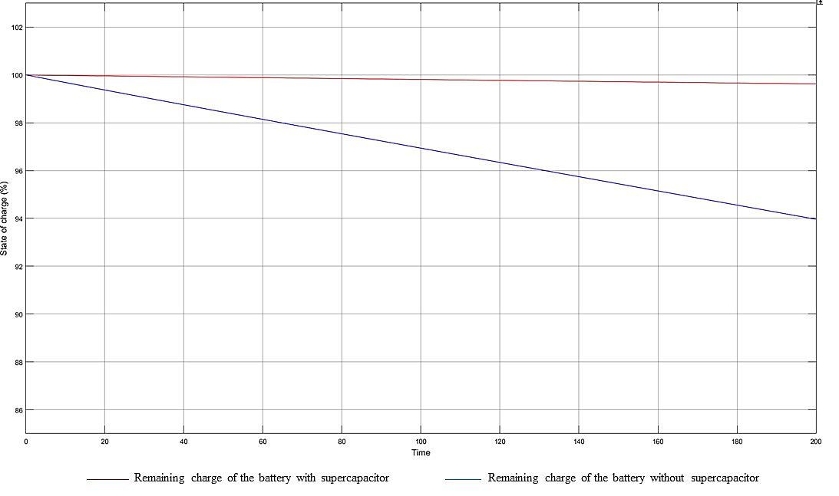
Hybrid Energy Storage System
. The studies showed that remaining capacity
of battery extended up to 6.4% and 18% depending on the load scenarios. Furthermore, it is
observed that battery DOD is reduced from 50% to 36% as the ultracapacitor supplies the peak
load demand .
Comparison between state of charge of the battery with and without the supercapacitor

Slide 13
Conclusion
The main reason for including the ultracapacitor is to reduce the discharge rate of battery during the peak load scenario, thus, extend the lifetime of battery as well as overall missions.
The parameter identification is crucial as it reflect the modelling of the supercapacitor , the modelling is important in simulating the supercapacitor for estimating the state of charge,. Hence the extracted parameter should be able to reflect the behavior of supercapacitor in real life application.

